Slide 1





4th International Conference on Electrical, Computer and Communication Engineering (ECCE 2025)
CUET, Chattogram, Bangladesh
13th-15th February 2025
Paper ID:
477
Topic:
Flood Area Detection and Segmentation Using Satellite Image in Bangladesh by U-Net: A Deep Learning Approach
MD ASHIKUZZAMAN¹, Md AL Emran¹, Md. Kornel Ahmed Rahul¹(Presenting), Shahriar Asif Ornab², Mijanur Rahman¹, Shamsul Abedin³
¹Pabna University of Science and Technology, Pabna, Bangladesh
²Ahsanullah University of Science and Technology, Dhaka, Bangladesh
³Intel Corporation, California, USA

Slide 2

Introduction
Flooding is a major natural disaster that causes significant financial losses worldwide.
Traditional flood detection uses hydrological models and manual analysis, often lacking accuracy and efficiency.
This study proposes a U-Net-based approach for flood area detection and segmentation in Bangladesh’s Feni district, improving flood response and mitigation strategies.
1
CUET, Chattogram, Bangladesh
13th – 15th February 2025
CUET IT Business Incubator, Chattogram, Bangladesh 25th & 26th September 2024

Slide 3
Problem Statement
Flooding causes severe crises, while existing detection methods struggle with data inconsistencies, accessibility, and accuracy.
An automated system is needed for real-time monitoring and improved disaster response.
2
CUET, Chattogram, Bangladesh
13th – 15th February 2025
CUET IT Business Incubator, Chattogram, Bangladesh 25th & 26th September 2024

Slide 4
Related work
Author | Used Models | Results | Limitations
F. Safavi and M. Rahnemoonfar | SegFormerB0, DDRNet-23, and PIDNet-s | 89.5%, 80.3% and 80.6% respectively | Limited to aerial imagery, making generalization difficult.
B. Basnyat, N. Roy, and A. Gangopadhyay | Standard U-Net and U-Net with drop out | 82% and 84% accuracy | Limited labeled data reduces robustness and generalization capability.
R. K. Sinha, M. Kushwaha, J. Choudhary, D. P. Singh, and M. Pandey | U-Net and DeepLabv3 | 89.74% and 92.16% accuracy | High computational resources, making real-time detection difficult.
B. Bahrami and H. Arbabkhah | SegNet, U-Net, and FCN32 | accuracy of 88% | Lower Dice coefficient compared to other models
M. Mesvari et al | UNET++, UNet, and FPN | Accuracy of 84.77% | Lower Dice coefficient
3
CUET, Chattogram, Bangladesh
13th – 15th February 2025
CUET IT Business Incubator, Chattogram, Bangladesh 25th & 26th September 2024

Slide 5
Contrast with Related works
Higher Accuracy and Robustness.
Focus on Real-Time and Practical Applications.
Improved Training and Optimization Techniques.
Better Adaptability and Generalization.
Efficient Model Architecture for Improved Performance.
This paper outperforms prior research by providing a highly accurate, adaptable, and optimized deep learning-based flood detection system, making it superior in practical flood management applications.
4
CUET, Chattogram, Bangladesh
13th – 15th February 2025
CUET IT Business Incubator, Chattogram, Bangladesh 25th & 26th September 2024

Slide 6
Research Questions
How can deep learning improve flood detection with high accuracy?
Can U-Net effectively segment flood areas in satellite images?
How does the proposed model perform compared to traditional hydrological models?
5
CUET, Chattogram, Bangladesh
13th – 15th February 2025
CUET IT Business Incubator, Chattogram, Bangladesh 25th & 26th September 2024

Slide 7
Objectives
Develop a U-Net-based model for flood area detection and segmentation.
Achieve high accuracy in identifying flood-prone regions.
Provide a reliable tool for real-time flood mapping and disaster response.
6
CUET, Chattogram, Bangladesh
13th – 15th February 2025
CUET IT Business Incubator, Chattogram, Bangladesh 25th & 26th September 2024

Slide 8
Outcomes and Impacts
Outcomes
Model achieved 93.3% training accuracy and 90% validation accuracy.
Enhanced flood detection capabilities for disaster management.
Impacts
Improved emergency response and resource allocation.
Potential for global application in flood-prone areas.
7
CUET, Chattogram, Bangladesh
13th – 15th February 2025
CUET IT Business Incubator, Chattogram, Bangladesh 25th & 26th September 2024

Slide 9
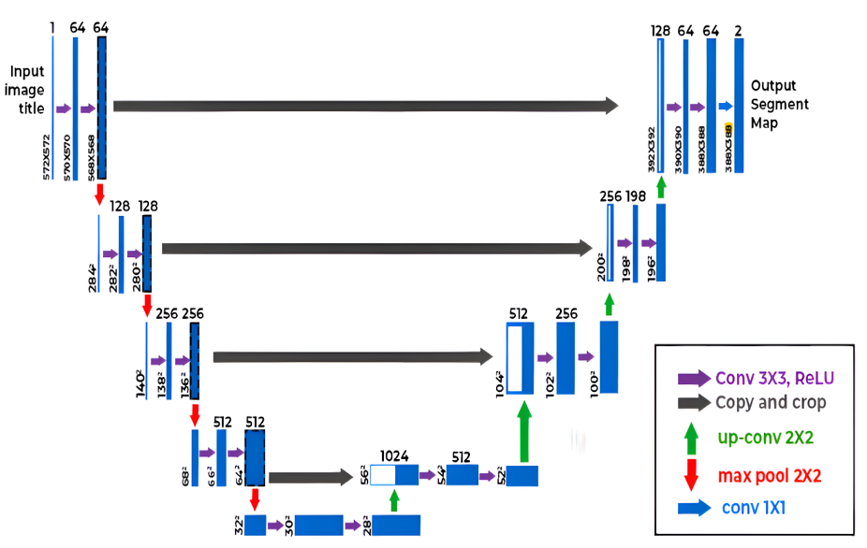
Methodology
Dataset Used: 290 satellite images from Feni district, Bangladesh.
Number of images: 290
Image size used: 224x224 pixels.
Image format: RGB
Data source: Kaggle
Data Split:
Training Set: 80% of the dataset.
Testing Set: 20% of the dataset.
Fig: U-Net Architecture Block Diagram
8
CUET, Chattogram, Bangladesh
13th – 15th February 2025
CUET IT Business Incubator, Chattogram, Bangladesh 25th & 26th September 2024

Slide 10
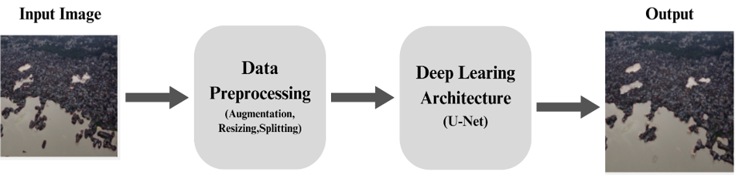
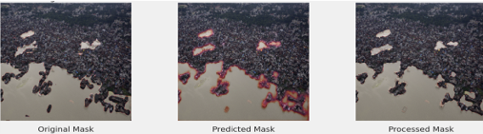
Methodology
Fig: A Flow chart that provides an overview of this study.
Fig: Satellite Images (Original and Corresponding Mask)
Preprocessing: Normalization, resizing, and data augmentation (rotation, flipping, brightness adjustment).
Training: Adam optimizer with IoU loss function. 100 epochs with batch processing.
9
CUET, Chattogram, Bangladesh
13th – 15th February 2025
CUET IT Business Incubator, Chattogram, Bangladesh 25th & 26th September 2024

Slide 11

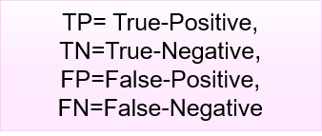
Experimental Results
Equations for Result Evaluation
Epochs | Training Loss | Validation Loss | Training Accuracy | Validation Accuracy
After 20 Epochs | 0.312 | 0.541 | 86.4% | 73.2%
After 40 Epochs | 0.232 | 0.482 | 88.7% | 80.1%
After 60 Epochs | 0.191 | 0.392 | 91.3% | 83.4%
After 80 Epochs | 0.125 | 0.285 | 93.2% | 88.6%
After 100 Epochs | 0.123 | 0.254 | 93.3% | 90.0%
After 100 epochs, the model achieved a training accuracy of 93.3% and a validation accuracy of 90.0%.
10
CUET, Chattogram, Bangladesh
13th – 15th February 2025
CUET IT Business Incubator, Chattogram, Bangladesh 25th & 26th September 2024

Slide 12
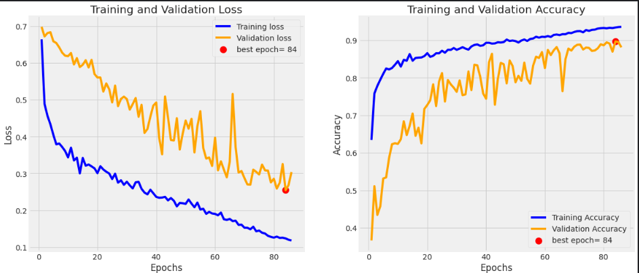
Experimental Results
It illustrates the model's improvement, with loss decreasing and accuracy increasing over 100 epochs, showing good generalization.
The best epoch with 90% validation accuracy.
Fig: Training and Validation Loss (left) and Accuracy (right) over Epochs
11
CUET, Chattogram, Bangladesh
13th – 15th February 2025
CUET IT Business Incubator, Chattogram, Bangladesh 25th & 26th September 2024

Slide 13
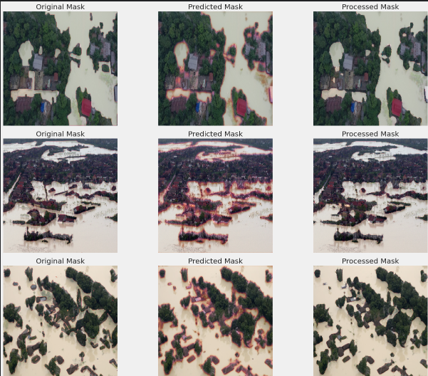
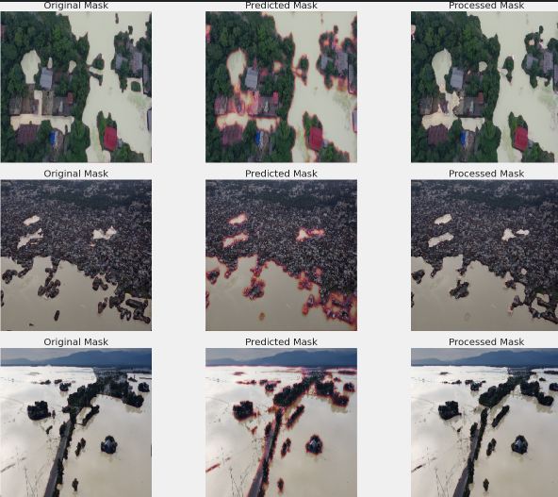
Experimental Results
Fig: Original Mask, Predicted Mask and Processed Mask for selected flood scenarios.
12
CUET, Chattogram, Bangladesh
13th – 15th February 2025
CUET IT Business Incubator, Chattogram, Bangladesh 25th & 26th September 2024

Slide 14
Conclusion
This study presents a U-Net-based deep learning model for flood detection, achieving 90% validation accuracy.
The model’s adaptability ensures effective segmentation of flooded areas, especially in flood-prone regions like Bangladesh.
It’s efficiency and scalability make it a valuable tool for real-time disaster mitigation.
It enhances urban planning and flood response strategies.
This approach sets the foundation for advanced, automated flood detection and climate resilience.
13
CUET, Chattogram, Bangladesh
13th – 15th February 2025
CUET IT Business Incubator, Chattogram, Bangladesh 25th & 26th September 2024

Slide 15
Future Research Direction
We will focus on enhancing U-Net’s resilience by integrating diverse geographical data and climate variations.
Our aim is to develop an efficient flood surveillance framework for rapid detection, disaster protection, and informed decision-making to minimize economic impact.
14
CUET, Chattogram, Bangladesh
13th – 15th February 2025
CUET IT Business Incubator, Chattogram, Bangladesh 25th & 26th September 2024

Slide 16
References
[1] F. Safavi and M. Rahnemoonfar, “Comparative Study of Real-Time Semantic Segmentation Networks in Aerial Images During Flooding Events,” IEEE J Sel Top Appl Earth Obs Remote Sens, vol. 16, pp. 15–31, 2023, doi: 10.1109/JSTARS.2022.3219724.
[2] B. Basnyat, N. Roy, and A. Gangopadhyay, “Flood Detection using Semantic Segmentation and Multimodal Data Fusion,” 2021 IEEE International Conference on Pervasive Computing and Communications Workshops and other Affiliated Events, PerCom Workshops 2021, pp. 135–140, Mar. 2021, doi: 10.1109/PERCOMWORKSHOPS51409.2021.9430985.
[3] R. K. Sinha, M. Kushwaha, J. Choudhary, D. P. Singh, and M. Pandey, “Flood Image Segmentation of UAV Aerial Images using Deep Learning,” 2024 IEEE International Students’ Conference on Electrical, Electronics and Computer Science, SCEECS 2024, 2024, doi: 10.1109/SCEECS61402.2024.10481993.
[4] B. Bahrami and H. Arbabkhah, “Enhanced Flood Detection Through Precise Water Segmentation Using Advanced Deep Learning Models,” Journal of Civil Engineering Researchers, vol. 6, no. 1, pp. 1–8, Mar. 2024, doi: 10.61186/JCER.6.1.1.
[5]R. Jaturapitpornchai, R. Saito, N. Kanemoto, and S. Kuzuoka, “Flood Area Detection from a Pair of Sentinel-1 Synthetic Aperture Radar Images Using Res-Unet Based Method,” International Geoscience and Remote Sensing Symposium (IGARSS), vol. 2022-July, pp. 1023–1026, 2022, doi: 10.1109/IGARSS46834.2022.9884744.
[6]M. Mesvari, R. S.-H.-E. O. and Geomatics, and undefined 2023, “Flood Detection Based on UNet++ Segmentation Method Using Sentinel-1 Satellite Imagery,” eoge.ut.ac.irM Mesvari, R Shah-HosseiniEarth Observation and Geomatics Engineering, 2023•eoge.ut.ac.ir, Accessed: Dec. 08, 2024. [Online]. Available: https://eoge.ut.ac.ir/article_94561_85037665880fd730fed00279404d936a.pdf
[7]“Flood Area Segmentation.” Accessed: Jan. 30, 2025. [Online]. Available: https://www.kaggle.com/datasets/faizalkarim/flood-area-segmentation
[8]O. Ronneberger, P. Fischer, and T. Brox, “U-Net: Convolutional Networks for Biomedical Image Segmentation,” Lecture Notes in Computer Science (including subseries Lecture Notes in Artificial Intelligence and Lecture Notes in Bioinformatics), vol. 9351, pp. 234–241, 2015, doi: 10.1007/978-3-319-24574-4_28.
15
CUET, Chattogram, Bangladesh
13th – 15th February 2025
CUET IT Business Incubator, Chattogram, Bangladesh 25th & 26th September 2024

Slide 17
Acknowledgement
We express our gratitude to Shamsul Abedin for his precise guidance and exceptional supervision.
16
CUET, Chattogram, Bangladesh
13th – 15th February 2025
CUET IT Business Incubator, Chattogram, Bangladesh 25th & 26th September 2024

Slide 18
Thank You !
CUET, Chattogram, Bangladesh
13th – 15th February 2025
CUET IT Business Incubator, Chattogram, Bangladesh 25th & 26th September 2024

